Slide 1
Calculating the Effects of Protectionist Policies

Slide 2
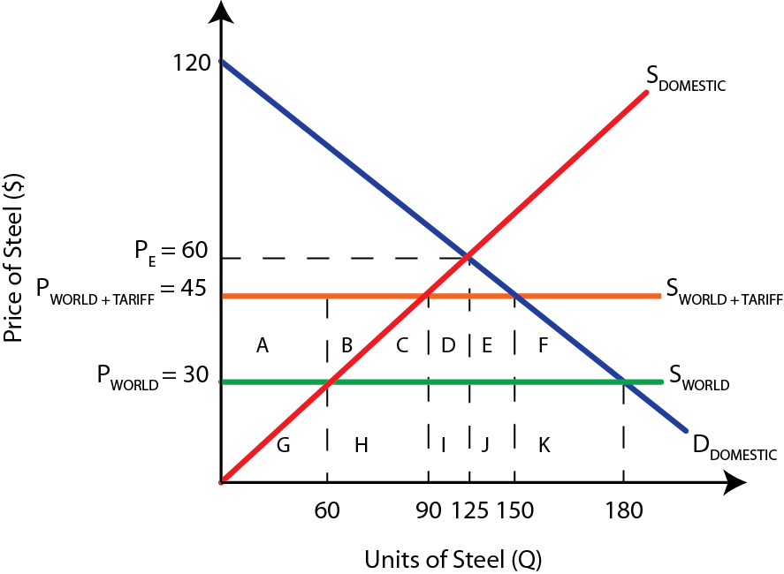
Tariffs
When given specific values for price and quantity, we can calculate the effects of protectionist policies on all relevant stakeholders: domestic and foreign producers, consumers, and the government
Example; The diagram below shows a tariff of $15 per unit placed on steel. Calculate the following before and after the tariff was implemented.
A. Domestic revenue
B. Foreign revenue
C. Consumer surplus
D. Government revenue
E. Welfare loss

Slide 3
A. Domestic revenue
Before: P_{WORLD} × Q_{DOMESTIC} = $30 × 60 = $1800
After: P_{TARRIF} × Q_{NEW DOMESTIC} = $45 × 90 = $4050
B. Foreign revenue
Before: P_{WORLD} × Q_{IMPORTS} = $30 × (180 – 60) = $3600
After: P_{WORLD} × Q_{NEW IMPORTS} = $30 × (150 – 90) = $1800
C. Consumer surplus
Before: ½(Highest price – P_{WORLD}) × Q_{WORLD} = 0.5(120 – 30) × 180 = $8100
After: ½(Highest price – P_{TARIFF}) × Q_{TARIFF} = 0.5(120 – 45) × 150 = $5625
D. Government revenue
Before: $0 = No tax collected
After: (P_{TARIFF} × P_{WORLD}) × Q_{NEW IMPORTS} = ($45 – $30 ) × (150 – 90) = $900
E. Welfare loss: (Area C + F)
After: 2(0.5(30 × 15)) = 2 × 225 = $450

Slide 4
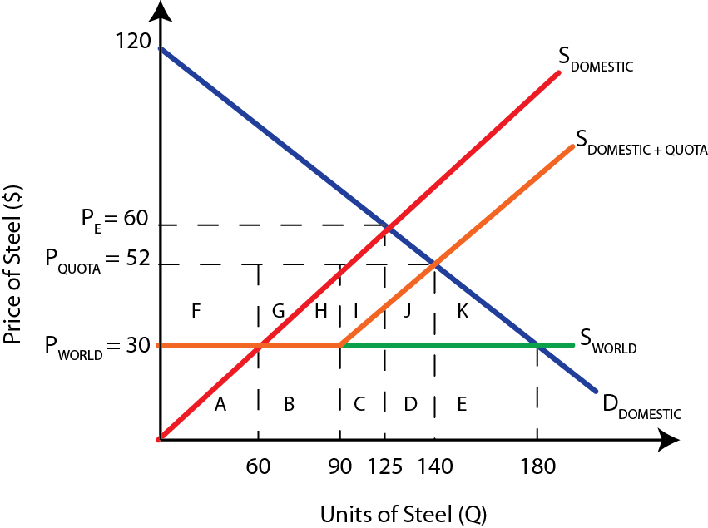
Quotas
Example; The diagram below shows a quota of 30 imported units of steel. Domestic producers previously sold 60 units at the world price of $30. After the quota, they are paid $52 and sell 110.
Calculate the following before and after the quota was implemented.
A. Domestic revenue
B. Foreign revenue
C. Consumer surplus
D. Government revenue
E. Welfare loss

Slide 5
A. Domestic revenue
Before: P_{WORLD} × Q_{DOMESTIC} = $30 × 60 = $1800
After: P_{QUOTA} × Q_{NEW DOMESTIC} = $52 × ((60 – 0) + (140 – 90)) = $5720
B. Foreign revenue
Before: P_{WORLD} × Q_{IMPORTS} = $30 × (180 – 60) = $3600
After: P_{WORLD} × Q_{NEW IMPORTS} = $52 × (90 – 60) = $1560
C. Consumer surplus
Before: ½(Highest price – P_{WORLD}) × Q_{WORLD} = 0.5(120 – 30) × 180 = $8100
After: ½(Highest price – P_{QUOTA}) × Q_{QUOTA} = 0.5(120 – 52) × 140 = $4760
D. Government revenue
Before: $0 = No tax collected
After: $0 = No tax collected
E. Welfare loss: (Area J + K)
After: 0.5(50 × 22) + 0.5(40 × 22) = $990

Slide 6
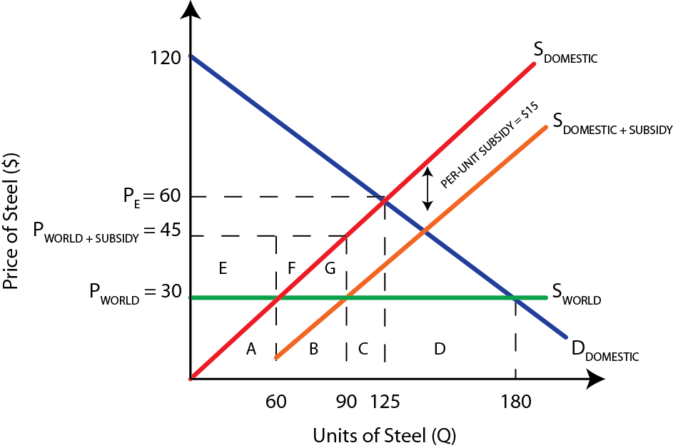
Subsidy
Example; The diagram below shows a per-unit subsidy of $15, the same value as the per unit tariff above. The subsidy is designed to reduce the number of imports
Calculate the following before and after the subsidy was implemented.
A. Domestic revenue
B. Foreign revenue
C. Consumer surplus
D. Government revenue
E. Welfare loss

Slide 7
A. Domestic revenue
Before: P_{WORLD} × Q_{DOMESTIC} = $30 × 60 = $1800
After: P_{QUOTA} × Q_{NEW DOMESTIC} = $45 × 90 = $4050
B. Foreign revenue
Before: P_{WORLD} × Q_{IMPORTS} = $30 × (180 – 60) = $3600
After: P_{WORLD} × Q_{NEW IMPORTS} = $30 × (180 – 90) = $2700
C. Consumer surplus
Before: ½(Highest price – P_{WORLD}) × Q_{WORLD} = 0.5(120 – 30) × 180 = $8100
After: ½(Highest price – P_{QUOTA}) × Q_{QUOTA} = 0.5(120 – 30) × 180 = $8100
D. Government revenue
Before: $0 = No subsidy paid
After: Per-unit subsidy × Q_{DOMESTIC} = $15 × 90 = $1350
E. Welfare loss: (Area G)
After: 0.5(15 × 30) = $225

Slide 8
Study Questions
1. Create a free trade diagram that has the following values
A supply curve with quantities 45 units at $15 and 30 units at $10
A demand curve with quantities 15 units at $15 and 30 units at $10
World price of $5 and domestic price of $10
At the world price, domestic quantity of 15
At the world price, foreign imports of 30
1b. Impose a tariff of $3. Draw the expected results for domestic/import quantities on your diagram. Based on your diagram calculate the following
Domestic producer revenue before & after the tariff
Foreign revenue before and after the tariff
Total tariff amount
Areas of inefficiency and welfare loss

